Slide 1

Predicting the World Cup Winner with the FIFA Ranking and
Elo Rating
System
Chris Lockwood
Constancio Hernandez

Slide 2


FIFA Ranking Method
Is it possible and reliable to predict the 2018 WorldCup Winner based on the FIFA Rankings?

Slide 3
FIFA Ranking Method
The basic logic of these calculations is simple:
Any team that does well in world football wins points which enable it to climb the world ranking.
A team’s total number of points over a four-year period is determined by adding:
The average number of points gained from matches during the past 12 months; and The average number of points gained from matches older than 12 months (depreciates yearly).
Calculation of points for a single match
The number of points that can be won in a match depends on the following factors:
Was the match won or drawn? (M) How important was the match (ranging from a friendly match to a FIFA World Cup™ match)? (I)How strong was the opposing team in terms of ranking position and the confederation to which they belong? (T and C)
These factors are brought together in the following formula to ascertain the total number of points (P):

Slide 4
FIFA Ranking FORMULA
Points = M x I x T x C
M: Points for match result I: Importance of match
T: Strength of opposing team C: Strength of confederation

Slide 5
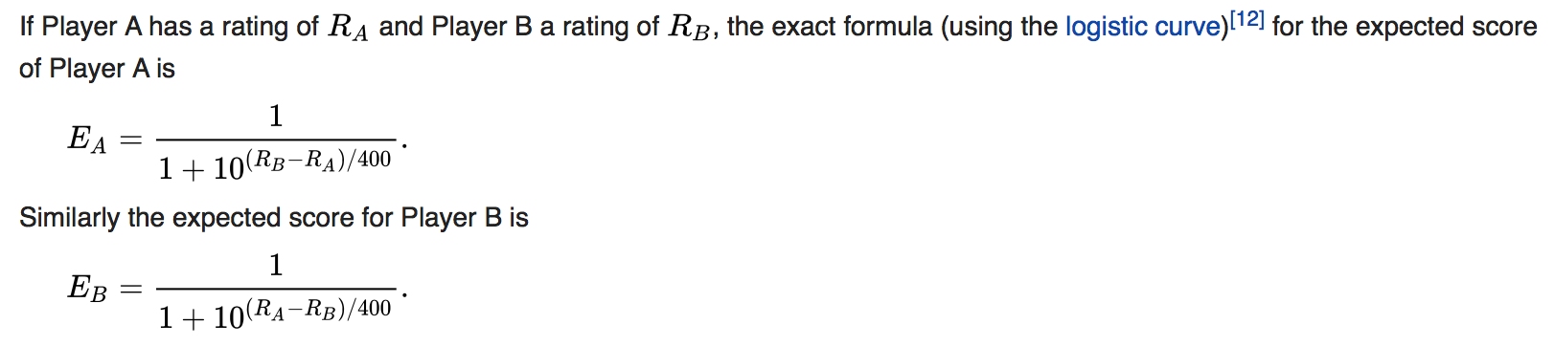
ELO Ranking System
The Elo system was originally invented as an improved chess rating system over the previously used Harkness system, but is also used as a rating system for multiplayer competition in a number of video games,[1] association football, American football, basketball,[2] Major League Baseball, Scrabble, board games such as Diplomacy and other games.
A player's Elo rating is represented by a number which increases or decreases depending on the outcome of games between rated players. After every game, the winning player takes points from the losing one. The difference between the ratings of the winner and loser determines the total number of points gained or lost after a game. In a series of games between a high-rated player and a low-rated player, the high-rated player is expected to score more wins. Arpad Elo was a master-level chess player and an active participant in the United States Chess Federation (USCF) from its founding in 1939.[3] The USCF used a numerical ratings system, devised by Kenneth Harkness, to allow members to track their individual progress in terms other than tournament wins and losses.

Slide 6
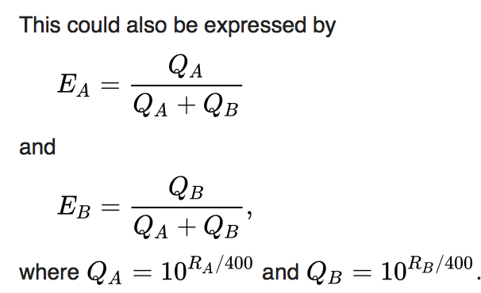
ELO Ranking System
Based on above conditions, code was created trying to predict the WINNER for the upcoming Russia 2018 Soccer World Cup.

Slide 7
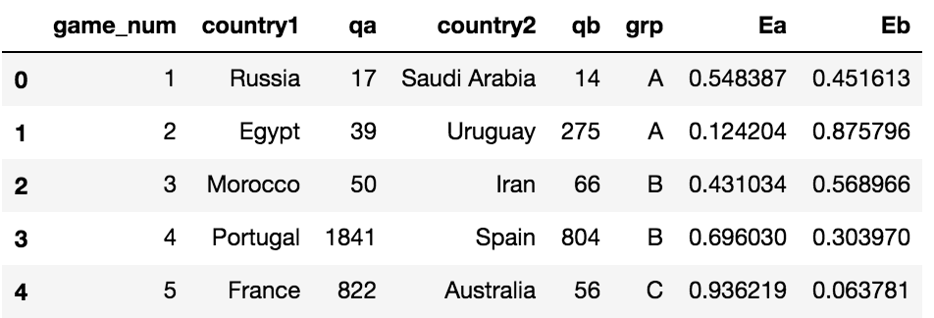
FIFA Rankings and Elo Rating Calculations
The table shown below was created using both the FIFA current rankings as of Jun.7th 2018 and using the ELO rating

Slide 8
World Cup 2018 Winner prediction
The scheduled games were used to calculate the ELO ratings on each of the games.

Slide 9
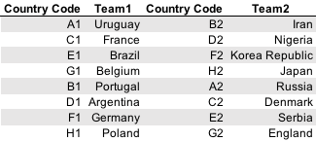
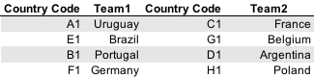
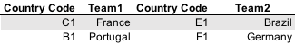
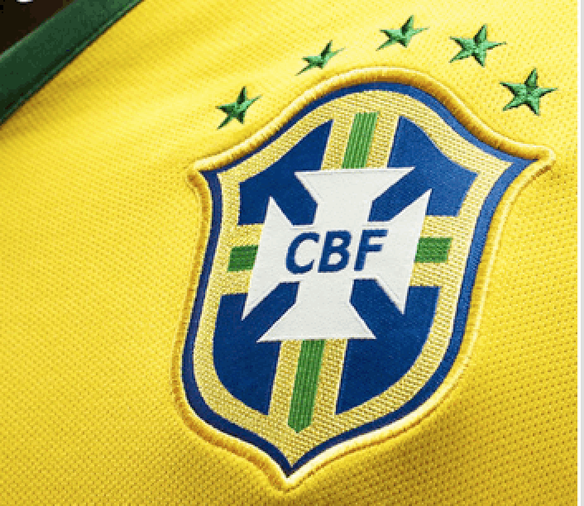
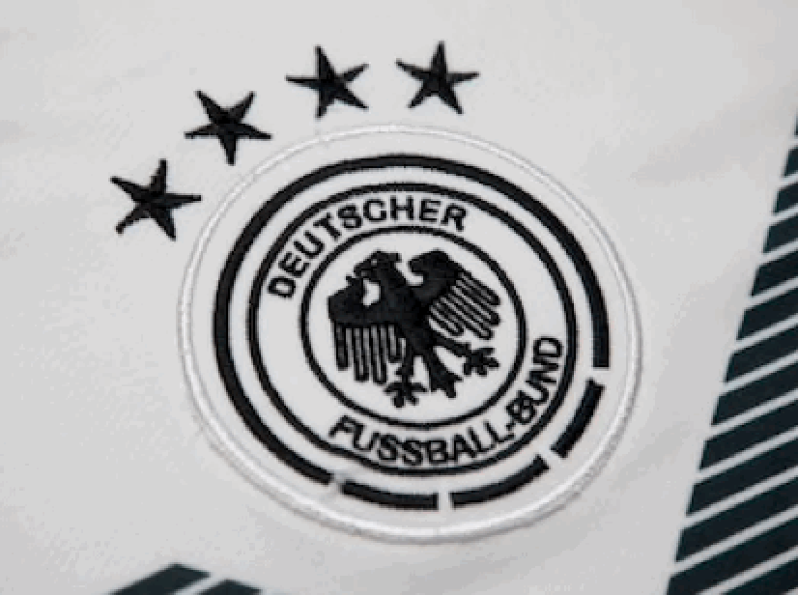
FIFA Rankings and Elo Rating Calculations
vs

Slide 10

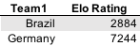


FIFA Rankings and Elo Rating Calculations
World Cup 2018 Winner

Slide 11
FIFA Rankings and Elo Rating Calculations
Conclusions:
Based on this prediction model, the previous two world cup information was
loaded in order to test the model accuracy.
Unfortunately, there was no correlation with the previous winners.
We concluded that using the FIFA rating to predict the winner is not accurate.
Next Steps:
Use some portion of the other presented model trying to improve the accuracy.

Slide 12
Tools and sources used
Tools: Pandas – Numpy – Matplotlib
Data Sources : FIFA.com (data)
Different websites understanding the ELO Rating
www.telegraph.co.uk
Wikipedia for text extraction – confirmed with FIFA data.

